Slide 1
Shared Memory
Inter Process Communication

Slide 2
Shared Memory
It allows two unrelated processes to access the same logical memory.
Shared memory is a very efficient way of transferring data between two running processes.
Since it provides no synchronization facilities, we usually need to use some other mechanism to synchronize access to the shared memory
Shared memory is a special range of addresses that is created by IPC for one process and appears in the address space of that process. Other processes can then “attach” the same shared memory segment into their own address space

Slide 3
Shared Memory(Continued)
All processes can access the memory locations just as if the memory had been allocated by malloc. If one process writes to the shared memory, the changes immediately become visible to any other process that has access to the same shared memory.
It’s the responsibility of the programmer to synchronize access.

Slide 4
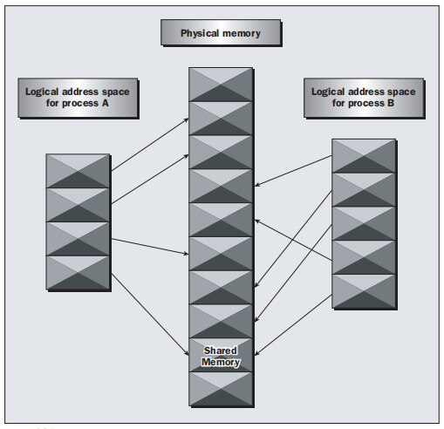

Slide 5
The functions for shared memory
#include <sys/shm.h>
void *shmat(int shm_id, const void *shm_addr, int shmflg);
int shmctl(int shm_id, int cmd, struct shmid_ds *buf);
int shmdt(const void *shm_addr);
int shmget(key_t key, size_t size, int shmflg);

Slide 6
shmget (create shared memory)
int shmget(key_t key, size_t size, int shmflg);
1st param -> The program provides key, which effectively names the shared memory segment, and the shmget function returns a shared memory identifier that is used in subsequent shared memory functions.
2nd param -> size, specifies the amount of memory required in bytes.
3rd param -> r, shmflg, consists of nine permission flags that are used in the same way as the mode flags for creating files. A special bit defined by IPC_CREAT must be bitwise ORed with the permissions to create a new shared memory segment

Slide 7
shmat (attach to the address space of a process)
void *shmat(int shm_id, const void *shm_addr, int shmflg);
1st param -> The shared memory identifier returned from shmget.
2nd param -> The address at which the shared memory is to be attached to the current process. This should almost always be a null pointer, which allows the system to choose the address at which the memory appears.
3rd param -> shmflg, is a set of bitwise flags. The two possible values are SHM_RND, which, in conjunction with shm_addr, controls the address at which the shared memory is attached, and SHM_RDONLY, which makes the attached memory read-only

Slide 8
shmdt (detaches the shared memory)
The shmdt function detaches the shared memory from the current process. It takes a pointer to the address returned by shmat. On success, it returns 0, on error –1.
Note that detaching the shared memory doesn’t delete it; it just makes that memory unavailable to the current process.

Slide 9
shmctl ( control functions for shared memory)
int shmctl(int shm_id, int command, struct shmid_ds *buf);
1st param -> shm_id, is the identifier returned from shmget.
2nd param -> command, is the action to take.
It can take three values: Command Description
IPC_STAT Sets the data in the shmid_ds structure to reflect the values associated with the shared memory.
IPC_SET Sets the values associated with the shared memory to those provided in the shmid_ds data structure, if the process has permission to do so.
IPC_RMID Deletes the shared memory segment.
3rd param -> buf, is a pointer to structure containing the modes and permissions for the shared memory.

Slide 10
Program
First, we create a common header file to describe the shared memory we wish to pass around.
We call this shm_com.h.
#define TEXT_SZ 2048
struct shared_use_st {
int written_by_you;
char some_text[TEXT_SZ];
}

Slide 11
consumer.c
#include <unistd.h>
#include <stdlib.h>
#include <stdio.h>
#include <string.h>
#include <sys/types.h>
#include <sys/ipc.h>
#include <sys/shm.h>
#include “shm_com.h”
int main()
{
int running = 1;
void *shared_memory = (void *)0;
struct shared_use_st
*shared_stuff;
int shmid;
shmid = shmget((key_t)1234, sizeof(struct
shared_use_st),
0666|IPC_CREAT);
if (shmid == -1) {
fprintf(stderr, “shmget
failed\n”);
exit(EXIT_FAILURE);
}

Slide 12
consumer.c (continued)
shared_memory = shmat(shmid, (void *)0, 0);
if (shared_memory == (void *)-1) {
fprintf(stderr, “shmat failed\n”);
exit(EXIT_FAILURE);
}
printf(“Memory attached at %X\n”,
(int)shared_memory);
shared_stuff = (struct shared_use_st *)
shared_memory;
shared_stuff->written_by_you = 0;
while(running) {
if (shared_stuff->written_by_you) {
printf(“You wrote: %s”,
shared_stuff->some_text);
sleep( rand() % 4 );
/* make the other process wait for
us ! */
shared_stuff->written_by_you = 0;
if (strncmp(shared_stuff->some_text,
“end”,3) == 0) {
running = 0;
}
}
}

Slide 13
consumer.c (continued)
if (shmdt(shared_memory) == -1) {
fprintf(stderr, “shmdt failed\n”);
exit(EXIT_FAILURE);
}
if (shmctl(shmid, IPC_RMID, 0) == -1) {
fprintf(stderr, “shmctl(IPC_RMID)
failed\n”);
exit(EXIT_FAILURE);
}
exit(EXIT_SUCCESS);
}

Slide 14
Producer.c
#include <string.h>
#include <sys/types.h>
#include <sys/ipc.h>
#include <sys/shm.h>
#include “shm_com.h”
int main()
{
int running = 1;
void *shared_memory = (void *)0;
struct shared_use_st *shared_stuff;
char buffer[BUFSIZ];
int shmid;
shmid = shmget((key_t)1234, sizeof(struct shared_use_st), 0666 | IPC_CREAT);
if (shmid == -1) {
fprintf(stderr, “shmget failed\n”);
exit(EXIT_FAILURE);
}
shared_memory = shmat(shmid, (void *)0, 0);
if (shared_memory == (void *)-1) {
fprintf(stderr, “shmat failed\n”);
exit(EXIT_FAILURE);
}
printf(“Memory attached at %X\n”, (int)shared_memory);
shared_stuff = (struct shared_use_st *)shared_memory;
while(running) {

Slide 15
Producer.c
while(shared_stuff->written_by_you == 1) {
sleep(1);
printf(“waiting for client...\n”);
}
printf(“Enter some text: “);
fgets(buffer, BUFSIZ, stdin);
strncpy(shared_stuff->some_text,
buffer, TEXT_SZ);
shared_stuff->written_by_you = 1;
if (strncmp(buffer, “end”, 3) == 0) {
running = 0;
}
}
if (shmdt(shared_memory) == -1){
fprintf(stderr, “shmdt failed\n”);
exit(EXIT_FAILURE);
}
exit(EXIT_SUCCESS);
}

